Slide 1
PDAT617: Python
Module 6 – Cluster Analysis

Slide 2
6.1 What is unsupervised learning?
A group of machine learning algorithms that find pattern in data
Data for algorithms has not been labeled, classified or characterized
The objective of the the algorithm is to interpret any structure in the data
Common unsupervised learning algorithms: cluster, neural network and anomaly detection

Slide 3
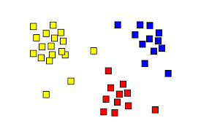
6.1 What is clustering?
The organization of unlabeled data into similarity groups called clusters.
A cluster is a collection of data items which are “similar” between them, and “dissimilar” to data items in other clusters.

Slide 4
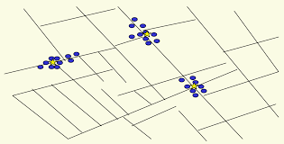
6.1 Historic application of clustering
John Snow, a London physician plotted the location of cholera deaths on a map during an outbreak in 1850s
The location indicated that cases were clustered around certain intersections where there were polluted wells – thus exposing both the problem and the solution

Slide 5
6.1 Clustering Algorithm
Hierarchical clustering
K means clustering
Other clustering algorithm: Density-based spatial clustering of applications with noise (DBSCAN), Gaussian Method.

Slide 6
6.2 Hierarchical algorithms
Hierarchical algorithms find successive cluster using previous established clusters. These algorithms can be either agglomerative(“bottom-up”) or divisive(“top-down)
Agglomerative algorithm begin with each element as a separate cluster and merge them into successively larger cluster
Divisive algorithm begin with the whole set and proceed to divided it into successively smaller cluster

Slide 7
6.2 Hierarchical algorithms
Types of hierarchical cluster:
Divisive (top down) clustering: Starts with all data points in one cluster, the root, then
Splits the root into a set of child clusters. Each child cluster is recursively divided further
stops when only singleton clusters of individual data points remain, i.e., each cluster with only a single point

Slide 8
6.2 Hierarchical algorithms
Agglomerative (bottom up) clustering: The dendrogram is built from the bottom level by
Initially each data points forms a clusters
Compute the distance matrix between the clusters
Repeat
Merge the two closet cluster
Update the distance matrix
stopping when all the data points are merged into a single cluster
Produce a dendrogram: hierarchical tree of clusters
The stopping criterion implemented in scikit-learn is the number of clusters, so similar clusters are merged until only the specified number of clusters are left.
Different definitions od distance lead to different algorithms.

Slide 9
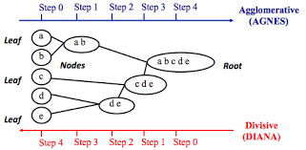
6.2 Hierarchical algorithms

Slide 10
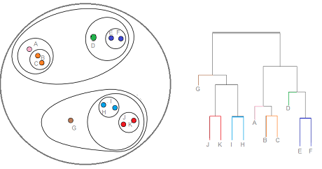
6.2 Hierarchical algorithms
Dendrogram
Given an input set S
Nodes represent subset of S
Features of the tree
The root is the whole input set S
The leaves are the individual elements of S
The internal nodes are defined as the union of their children

Slide 11
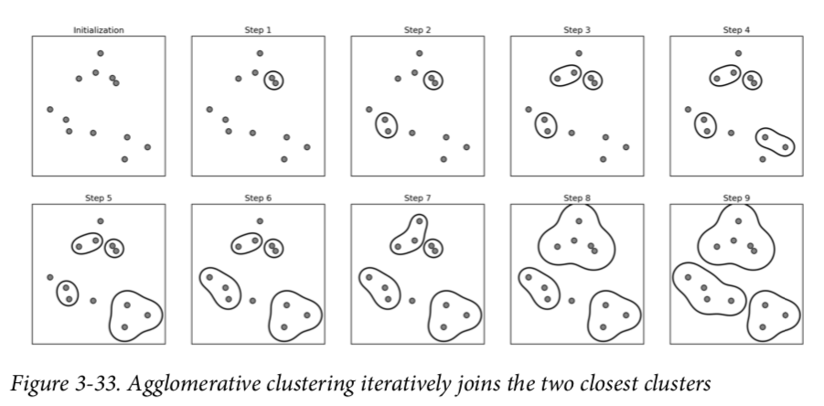
6.2 Hierarchical algorithms

Slide 12
6.2 Hierarchical algorithms
Linkage Criteria refers to how the distance between clusters is calculated.
Single Linkage: The distance between two clusters is the shortest distance between two points in each cluster.
Complete Linkage: The distance between two clusters is the longest distance between two points in each cluster.
Average Linkage: The distance between two clusters is the average distance between each point in one cluster to every point in other cluster.
Ward Linkage: The distance between two clusters is the sum of squared differences within all clusters.(By default)

Slide 13
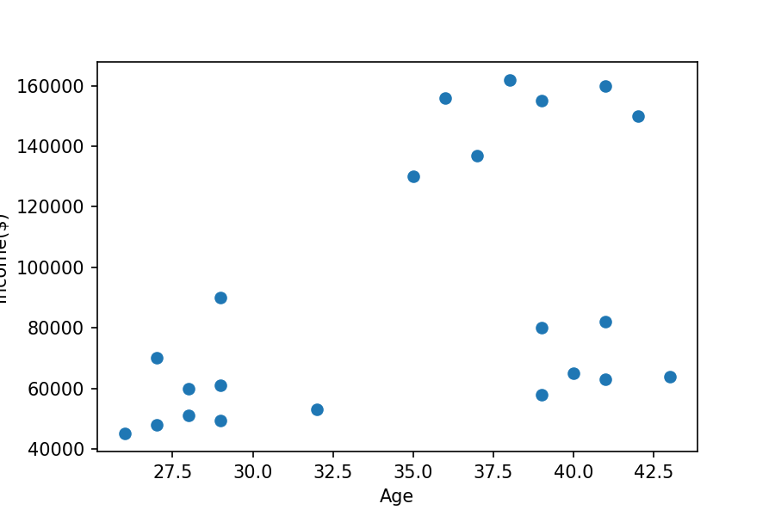
6.2 Hierarchical algorithms
Example: Identify some common characteristics for the given data set.(Higher salary or lower salary)
import pandas as pd
from sklearn.preprocessing import MinMaxScaler
from matplotlib import pyplot as plt
%matplotlib inline
df = pd.read_csv("income.csv")
plt.scatter(df.Age,df['Income($)'])
plt.xlabel('Age')
plt.ylabel('Income($)')

Slide 14
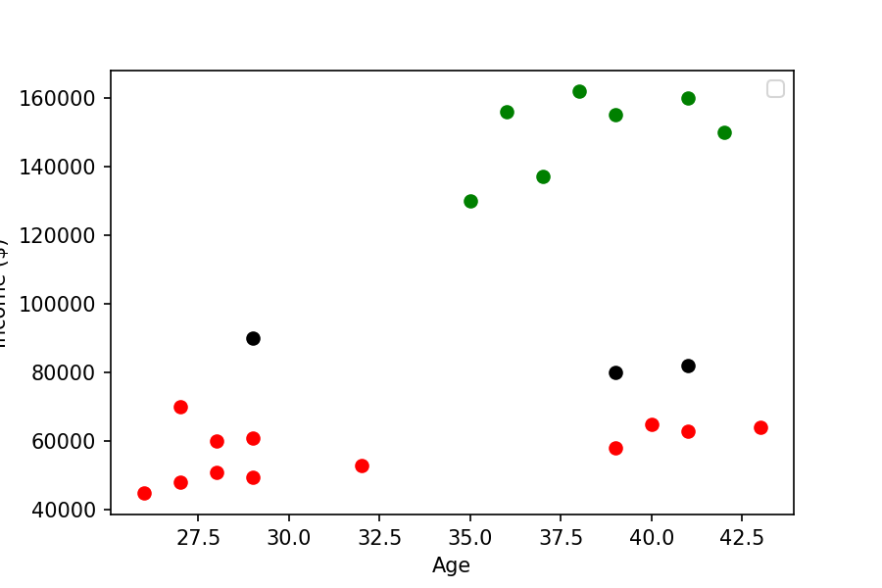
6.2 Hierarchical algorithms
from sklearn.cluster import AgglomerativeClustering
ac = AgglomerativeClustering(n_clusters=3, affinity='euclidean', linkage='ward')
df['cluster']=ac.fit_predict(df[['Age','Income($)']])
df1 = df[df.cluster==0]
df2 = df[df.cluster==1]
df3 = df[df.cluster==2]
plt.scatter(df1.Age,df1['Income($)'],color='green')
plt.scatter(df2.Age,df2['Income($)'],color='red')
plt.scatter(df3.Age,df3['Income($)'],color='black')
plt.xlabel('Age'
plt.ylabel('Income ($)')
plt.legend()

Slide 15
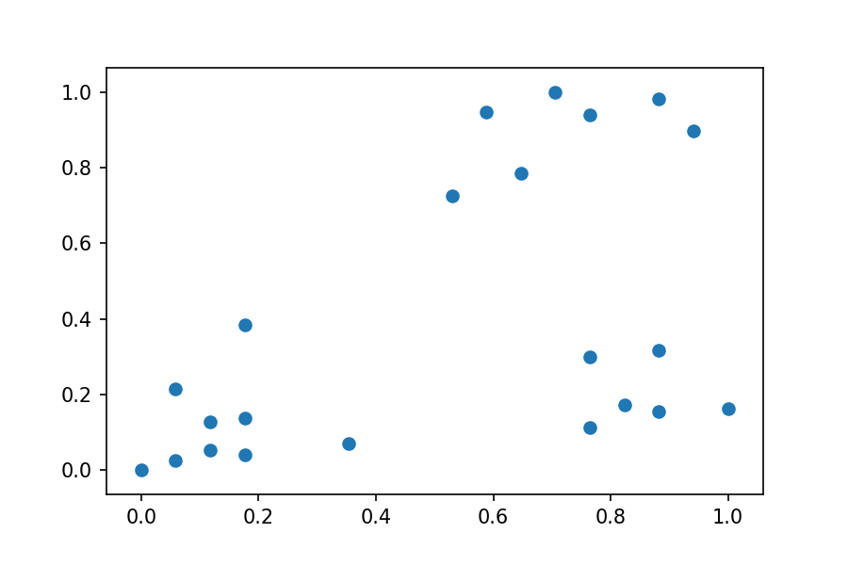
6.2 Hierarchical algorithms
from sklearn.preprocessing import MinMaxScaler
scaler = MinMaxScaler()
scaler.fit(df[['Income($)']])
df['Income($)'] = scaler.transform(df[['Income($)']])
scaler.fit(df[['Age']])
df['Age'] = scaler.transform(df[['Age’]])
plt.scatter(df.Age,df['Income($)'])
Normalization: process of rescaling of the data to a standard deviation of 1.

Slide 16
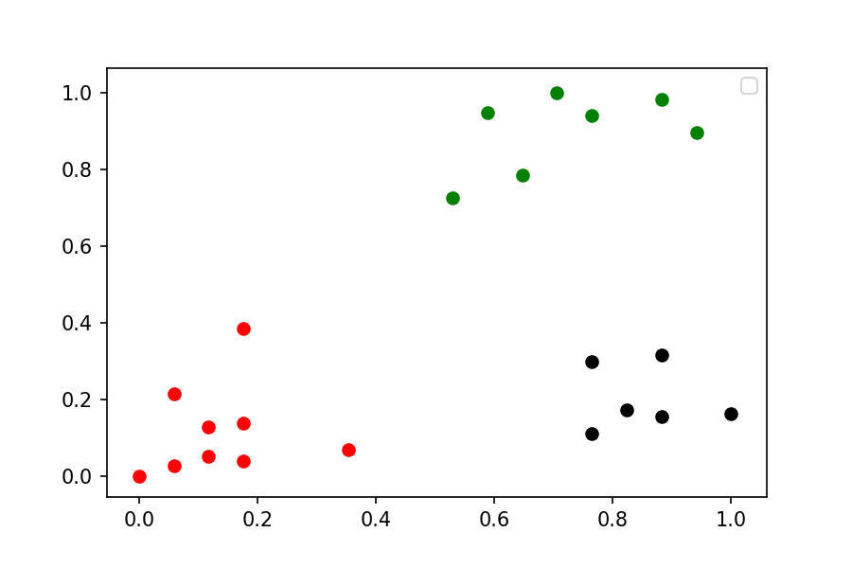
6.2 Hierarchical algorithms
acs = AgglomerativeClustering(n_clusters=3, affinity='euclidean', linkage='ward’)
df['cluster']=acs.fit_predict(df[['Age','Income($)’]])
df1 = df[df.cluster==0]
df2 = df[df.cluster==1]
df3 = df[df.cluster==2]
plt.scatter(df1.Age,df1['Income($)'],color='green')
plt.scatter(df2.Age,df2['Income($)'],color='red')
plt.scatter(df3.Age,df3['Income($)'],color='black')
plt.legend()

Slide 17
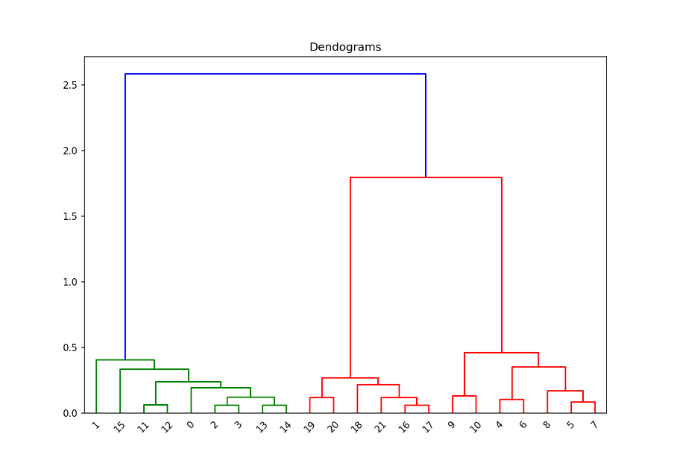
6.2 Hierarchical algorithms
import scipy.cluster.hierarchy as shc
plt.figure(figsize=(10, 7))
plt.title("Dendograms")
dend = shc.dendrogram(shc.linkage(df[['Age','Income($)']], method='ward'))

Slide 18
6.3 The k-means algorithm
K-means(MacQueen,1967) is a partitional clustering algorithm
The k-means algorithm partitions the given data into
k clusters:
Each cluster has a cluster center, called centroid.
k is specified by the user
Other clustering algorithm: Density-based spatial clustering(DBSCAN),
Gaussian Method.

Slide 19
6.3 The k-means algorithm
Given k, the k-means algorithm works as follows:
Choose k (random) data points (seeds) to be the initial centroids, cluster centers
Assign each data point to the closest centroid
Re-compute the centroids using the current cluster memberships
If a convergence criterion is not met, repeat steps 2 and 3

Slide 20
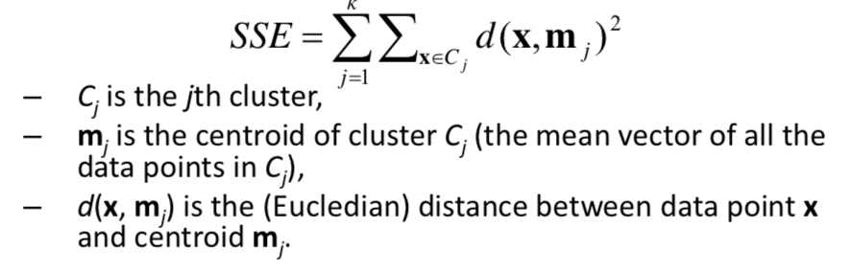
6.3 The k-means algorithm
K-means convergence (stopping) criterion
no (or minimum) re-assignments of data points to different clusters, or
no (or minimum) change of centroids, or
minimum decrease in the sum of squared error (SSE),

Slide 21
6.3 The k-means algorithm
Elbow method - Determine the correct number of cluster (K).
Distortion: Sum of squared distances of points from cluster centers.
Decrease with an increasing number of clusters
Becomes zero when the number of clusters equals to the number of points
Elbow plot: line plot between cluster center and distortion

Slide 22
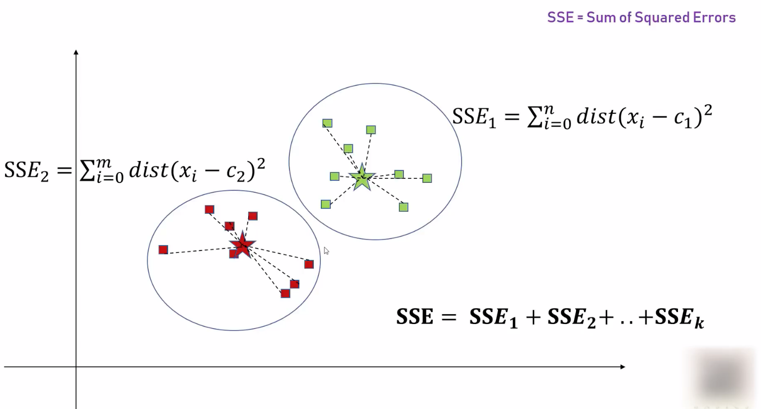
6.3 The k-means algorithm

Slide 23
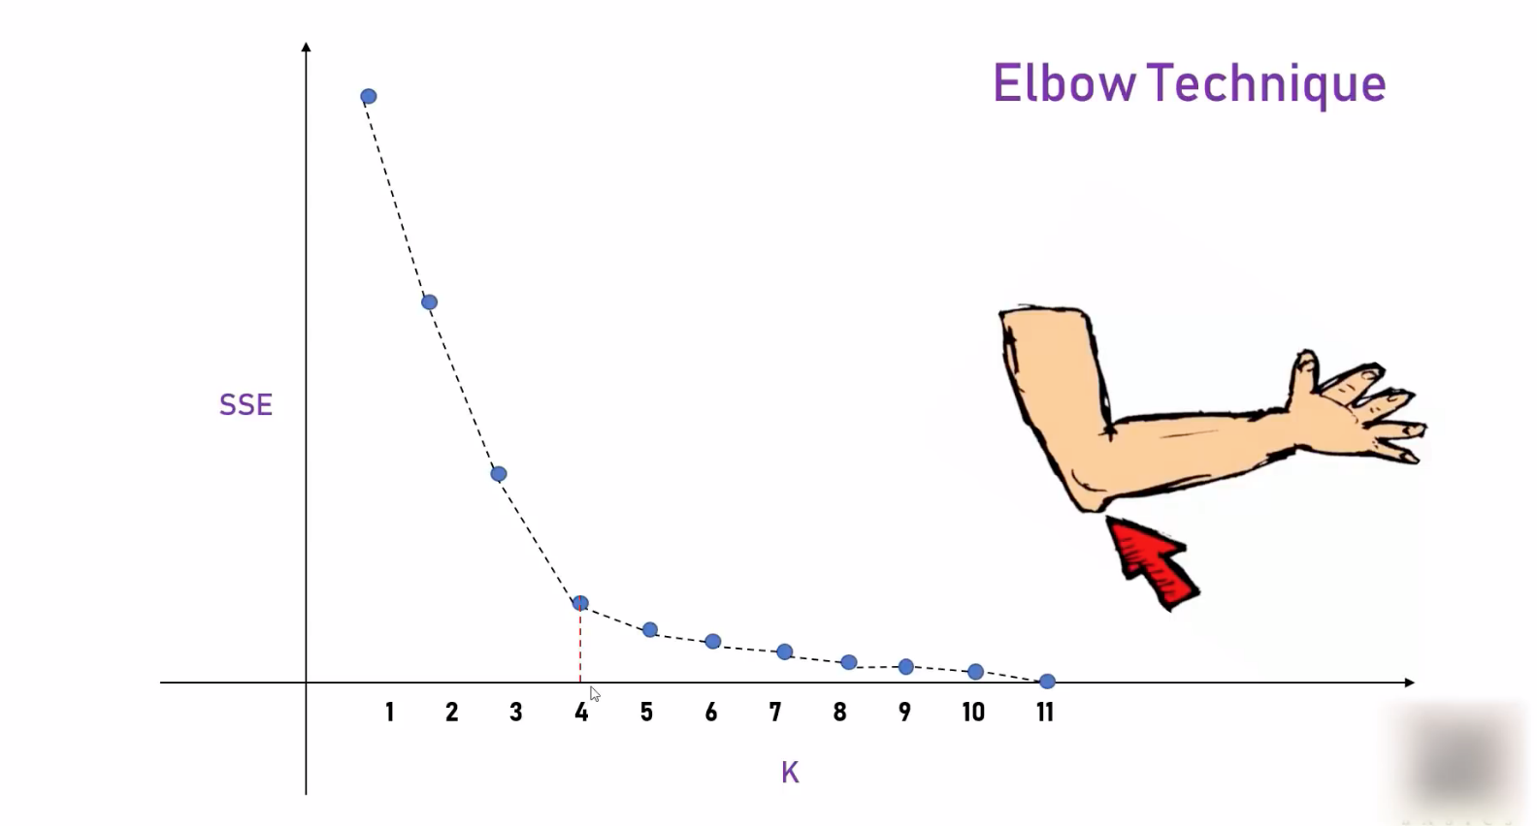
6.3 The k-means algorithm

Slide 24
6.3 The k-means algorithm
Example(Same): Identify some common characteristics for the given data set.(Higher salary or lower salary)
from sklearn.cluster import KMeans
import pandas as pd
from sklearn.preprocessing import MinMaxScaler
from matplotlib import pyplot as plt
%matplotlib inline
df = pd.read_csv("income.csv")
plt.scatter(df.Age,df['Income($)'])
plt.xlabel('Age')
plt.ylabel('Income($)')

Slide 25
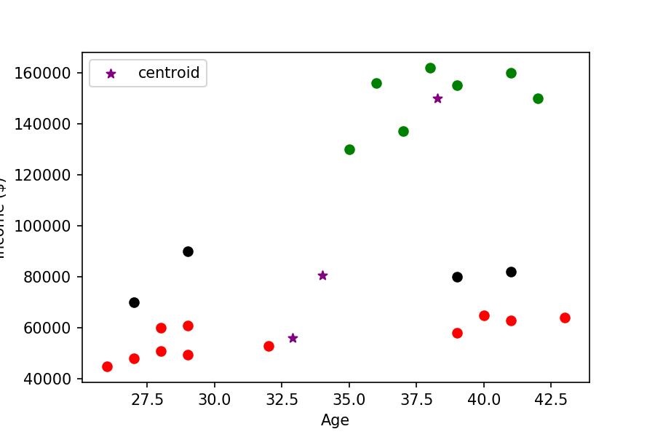
6.3 The k-means algorithm
km = KMeans(n_clusters=3)
y_predicted = km.fit_predict(df[['Age','Income($)’]])
df['cluster']=y_predicted
df1 = df[df.cluster==0]
df2 = df[df.cluster==1]
df3 = df[df.cluster==2]
plt.scatter(df1.Age,df1['Income($)'],color='green')
plt.scatter(df2.Age,df2['Income($)'],color='red')
plt.scatter(df3.Age,df3['Income($)'],color='black')
plt.scatter(km.cluster_centers_[:,0],km.cluster_centers_[:,1],color='purple',marker='*',label='centroid')
plt.xlabel('Age')
plt.ylabel('Income ($)')
plt.legend()
plt.savefig("6.2.png", dpi=150)

Slide 26
6.3 The k-means algorithm
scaler = MinMaxScaler()
scaler.fit(df[['Income($)']])
df['Income($)'] = scaler.transform(df[['Income($)']])
scaler.fit(df[['Age']])
df['Age'] = scaler.transform(df[['Age’]])
plt.scatter(df.Age,df['Income($)'])
Normalization: process of rescaling of the data to a standard deviation of 1.

Slide 27
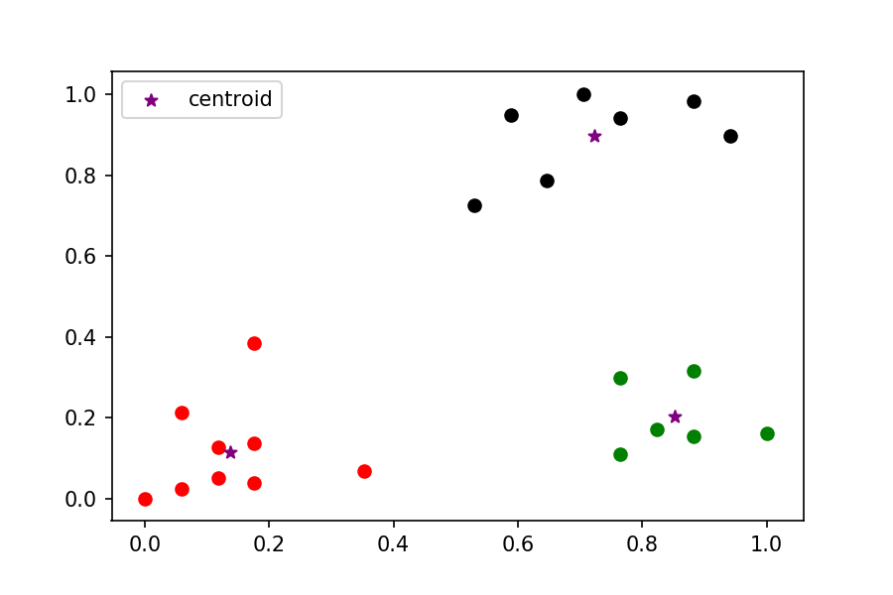
6.3 The k-means algorithm
km = KMeans(n_clusters=3)
y_predicted = km.fit_predict(df[['Age','Income($)’]])
df['cluster']=y_predicted
df1 = df[df.cluster==0]
df2 = df[df.cluster==1]
df3 = df[df.cluster==2]
plt.scatter(df1.Age,df1['Income($)'],color='green')
plt.scatter(df2.Age,df2['Income($)'],color='red')
plt.scatter(df3.Age,df3['Income($)'],color='black')
plt.scatter(km.cluster_centers_[:,0],km.cluster_centers_[:,1],color='purple',marker='*',label='centroid')
plt.legend()

Slide 28
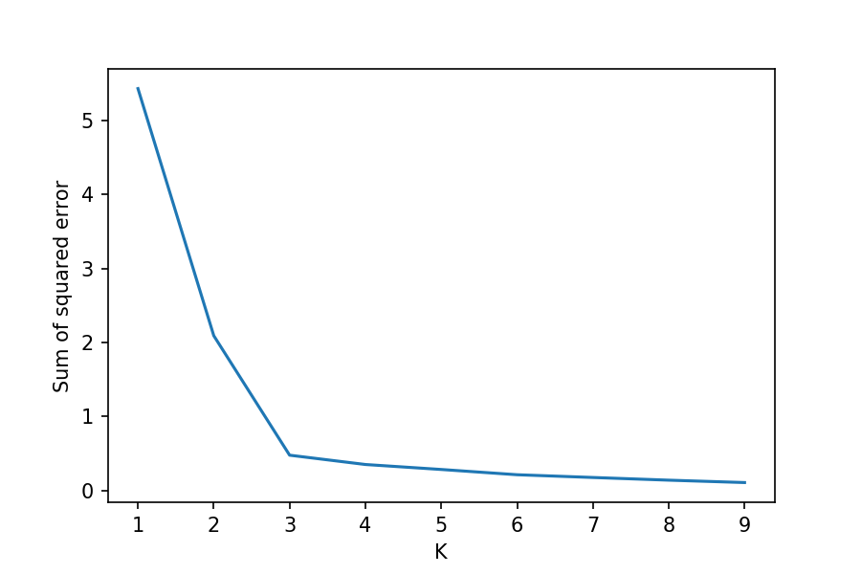
6.3 The k-means algorithm
sse = []
k_rng = range(1,10)
for k in k_rng:
km = KMeans(n_clusters=k)
km.fit(df[['Age','Income($)']])
sse.append(km.inertia_)
plt.xlabel('K')
plt.ylabel('Sum of squared error')
plt.plot(k_rng,sse)

Slide 29
6.4 Summary
Clustering has a long history and still is in active research
There are a huge number of clustering algorithms, among them: Density based algorithm, Sub-space clustering, Scale-up methods, Neural networks based methods, Fuzzy clustering, Co-clustering ...
More are still coming every year
Clustering is hard to evaluate, but very useful in practice
Clustering is highly application dependent (and to some extent subjective)

